Slide 1

DEPARTMENT OF PHYSICS
SRM INSTITUTE OF SCIENCE AND TECHNOLOGY
18PYB103J –Semiconduuctor Physics
Optical Transitions Using Fermi’s Golden Rule
18PYB101J Module-IV Lecture-7

Slide 2
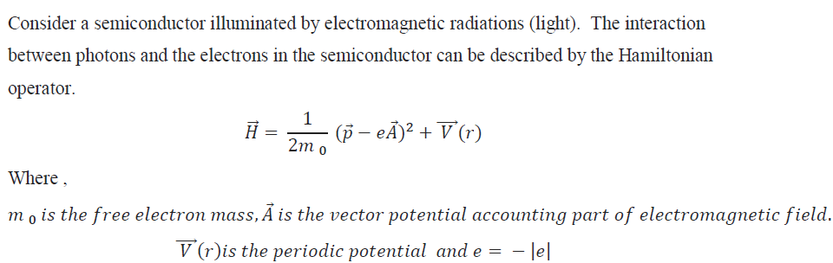
Optical Transitions Using Fermi’s Golden Rule
Introduction
Fermi’s golden rule is a simple expression for the transition probabilities between states of a quantum system, which are subjected to a perturbation. It is used for a large variety of physical systems covering, e.g., nuclear reactions, optical transitions, or scattering of electrons in solids.
18PYB101J Module-IV Lecture- 8

Slide 3
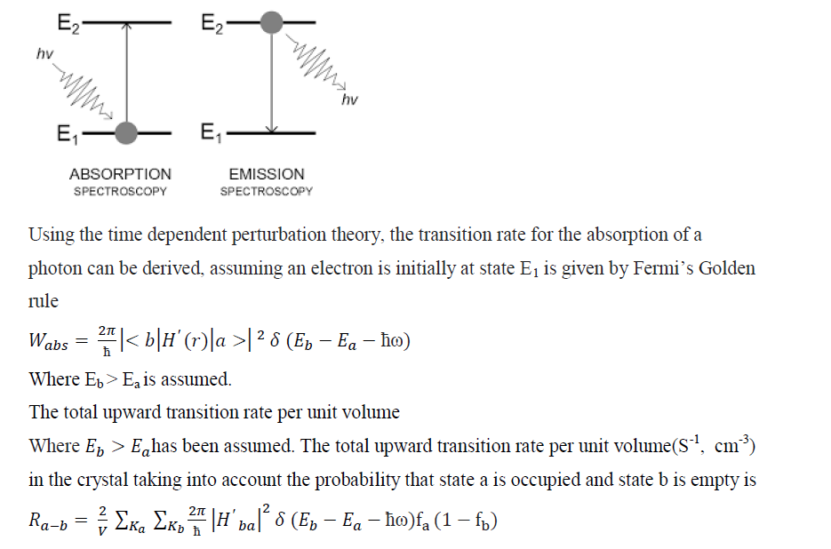
Optical Transitions Using Fermi’s Golden Rule
18PYB101J Module-IV Lecture-8

Slide 4
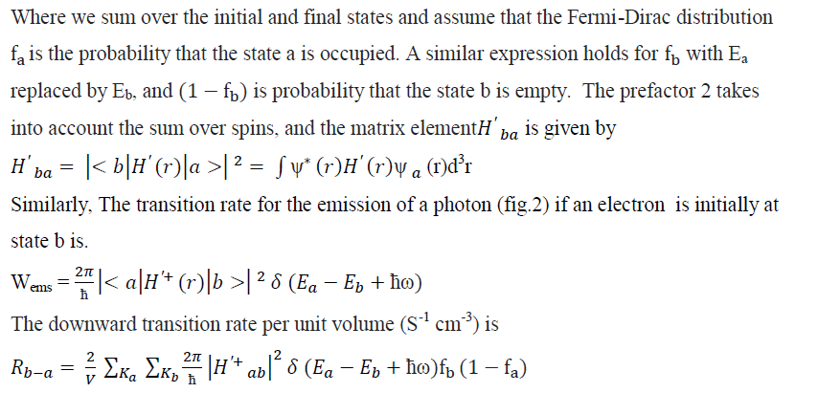
Optical Transitions Using Fermi’s Golden Rule
18PYB101J Module-IV Lecture-8

Slide 5
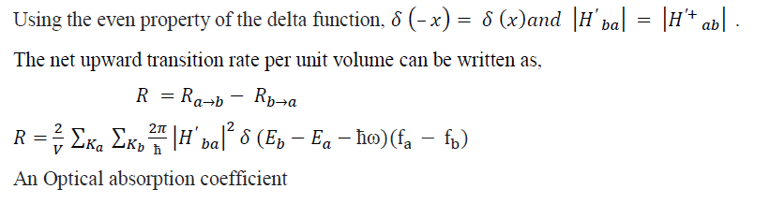
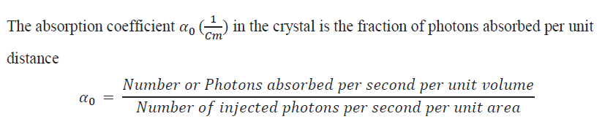
Optical Transitions Using Fermi’s Golden Rule
18PYB101J Module-IV Lecture-8

Slide 6
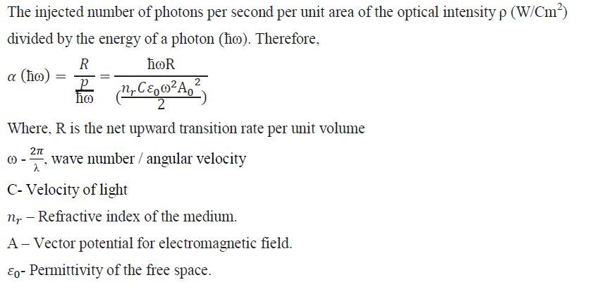
18PYB101J Module-IV Lecture-8

Slide 7
Thank you
18PYB101J Module-IV Lecture-8

